Slide 1
Mini Project on Cloud Computing
Presented By:
Aashis Kumar Chittawat
Dip Jyoti Dutta
Gaurab Paul
Mrinab Dey
Pankaj Kumar Sah

Slide 2
Introduction To Cloud Computing
What is Cloud Computing?
On demand delivery of computing services and
infrastructure.
Storing, processing and accessing data on
remote servers.
Why Cloud Computing?
Variety of services
Accessible from anywhere in the world
“Pay As You Go” model
What is Cloud Computing?
On demand delivery of computing services and infrastructure
Storing, processing and accessing data on remote servers
Why Cloud Computing?
Accessible from anywhere in the world
Provides variety of services

Slide 3



Types of Cloud
What is Cloud Computing?
On demand delivery of computing services and
infrastructure.
Storing, processing and accessing data on
remote servers.
Why Cloud Computing?
Variety of services
Accessible from anywhere in the world
“Pay As You Go” model
Public cloud Private cloud Hybrid cloud
Public Cloud
Accessible to the entire world
On demand services and infrastructure are provided by the cloud service provider
Resources are shared by multiple users
“Pay As You Go” model

Slide 4
Private and Hybrid Cloud
Private Cloud
On demand services and infrastructure are
hosted privately.
Accessible by authorized users only
Resources are dedicated to single organization
Hybrid Cloud
Combination of public and private cloud.
Versatility to switch between the two.
On demand services and infrastructure might be hosted publicly or privately.

Slide 5
 | Public Cloud | Private Cloud | Hybrid Cloud
Control | Minimal control | Maximum control | Moderate control
Complexity | Less complex | Can be highly complex | Medium complexity
Security | Managed by the cloud provider | Managed by single organisation | Managed both by cloud provider and the organisation
Scalability | Managed by the cloud provider | Managed by single organisation | Managed both by cloud provider and the organisation
Cost | Comparatively cheaper | Expensive | Moderate pricing

Slide 6
Recent Cloud Trends
Server less Computing
Disaster Recovery Services
Implementation of Cloud AI

Slide 7




Major Cloud Titans
Amazon web services
Google Cloud Platform
Microsoft Azure
Salesforce

Slide 8

About AWS
Amazon Web Services (AWS) began offering IT infrastructure services from 2006
Provides on-demand cloud computing platforms
APIs to individuals, companies, and governments, on a metered pay-as-you-go basis.
AWS offers tons of services but we’ve mainly used EC2 and S3 in this project.

Slide 9

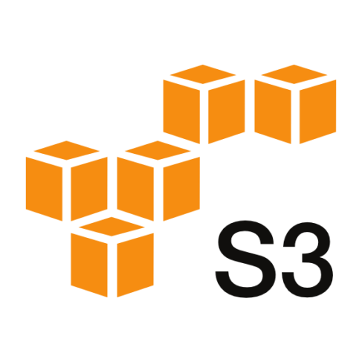

AWS Services Used
Amazon Elastic Compute Cloud (EC2)
Amazon EC2 is a basic virtual machine with customizable hardware components and an OS
Amazon S3
Amazon S3 provides object (file) storage through a web interface

Slide 10


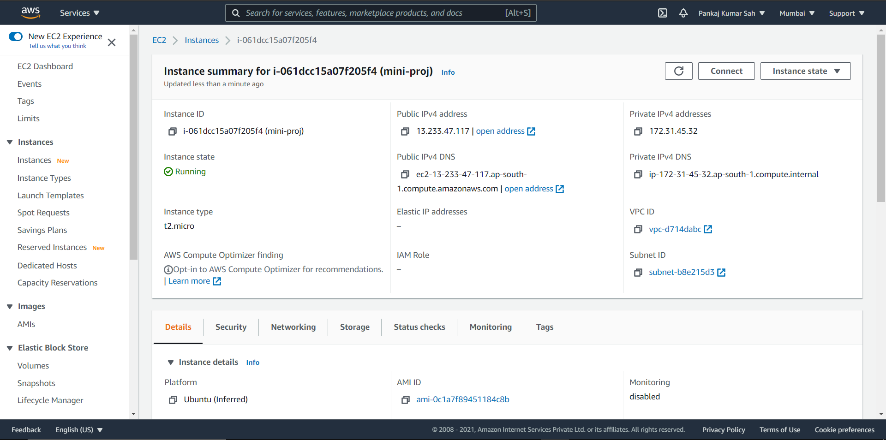
Launching EC2 Instance
The Instance was created using Ubuntu20.04 as the machine
This instance was then operated on our local pc using the command
ssh -i "mini-proj.pem" ubuntu@ec2-13-233-47-117.ap-south-1.compute.amazonaws.com

Slide 11


Inside the Instance
Apache as the Web Server
Apache2 was installed inside the VM(Virtual Machine) for serving the files on web
Inserting files on the server
The default index.html was removed and new files were inserted in the server using S3 bucket

Slide 12
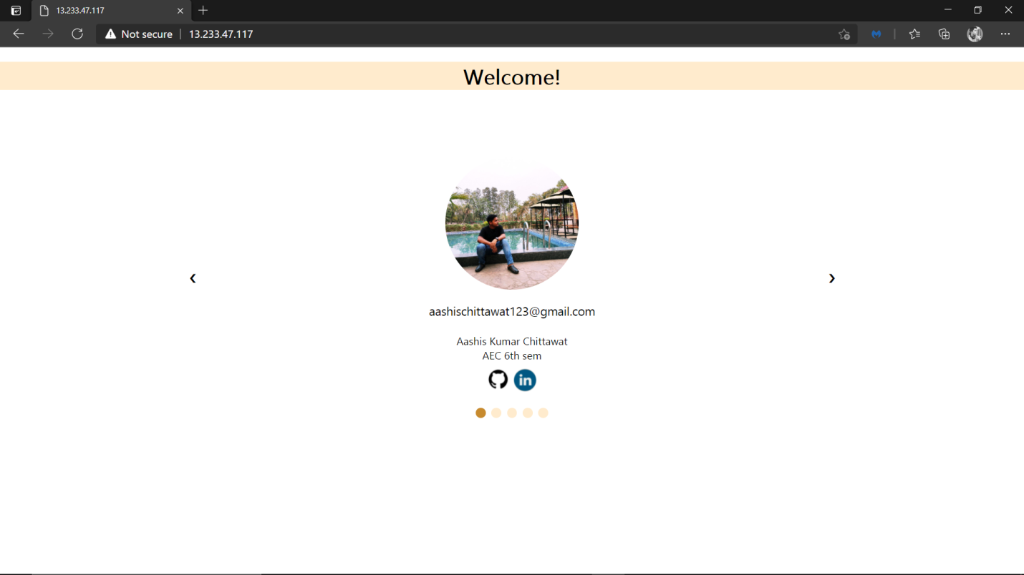
Launching the server
After launching the server, we got our site served at http://13.233.47.117/
13.233.47.117 was the Public IPv4 address of the instance

Slide 13
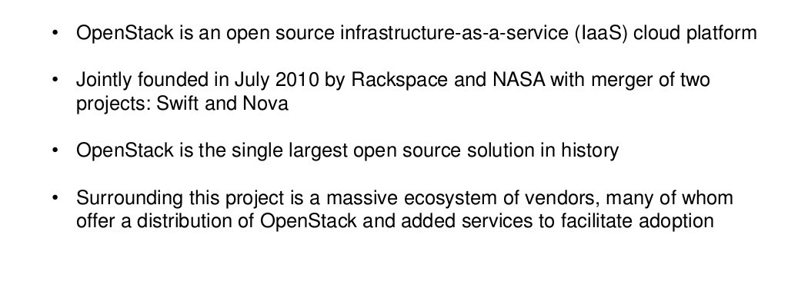
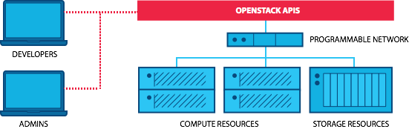
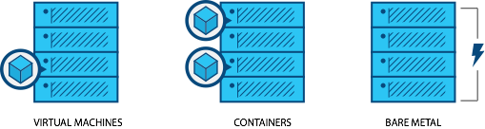

What is OpenStack?

Slide 14
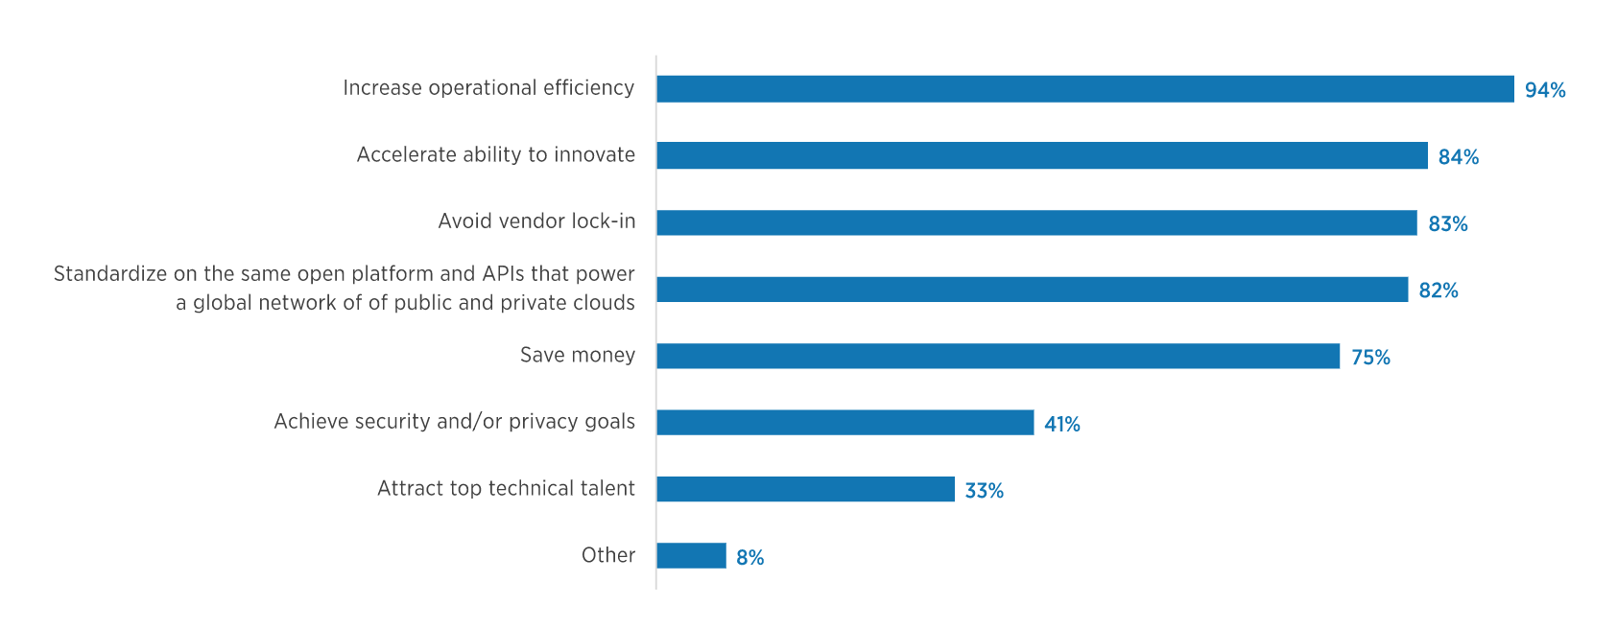
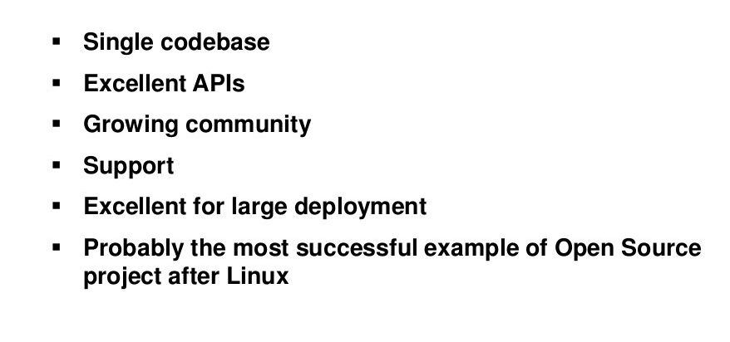

Why OpenStack?

Slide 15

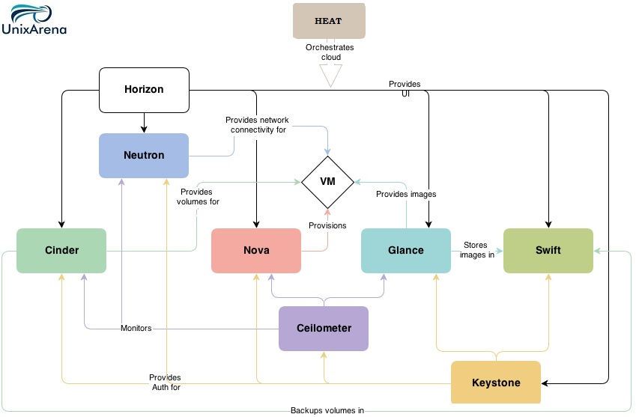
OpenStack Architecture

Slide 16

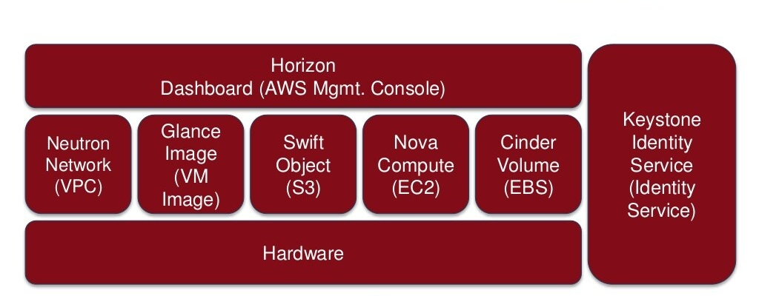
OpenStack Components

Slide 17
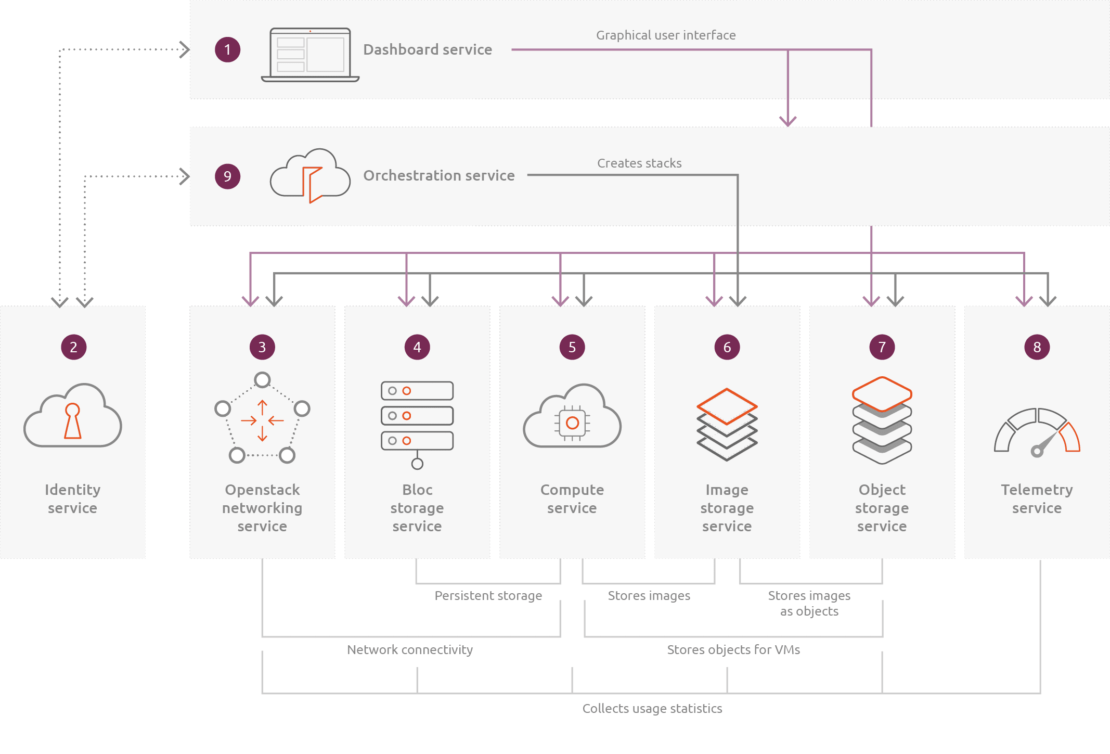
How Does OpenStack Work?

Slide 18
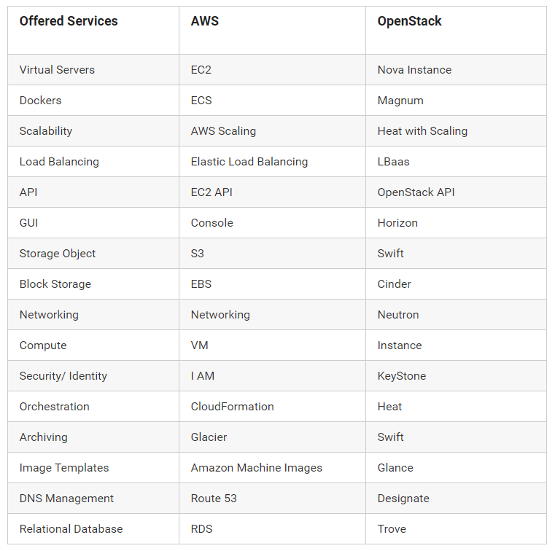

AWS vs OpenStack

Slide 19


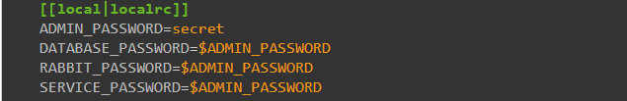
OpenStack Installation
Using DevStack: DevStack is a set of scripts and utilities to quickly deploy an OpenStack cloud from git source trees.
Add Stack User (optional) with root privileges
Download Dev Stack
Create a “local.conf” file
Start the install

Slide 20

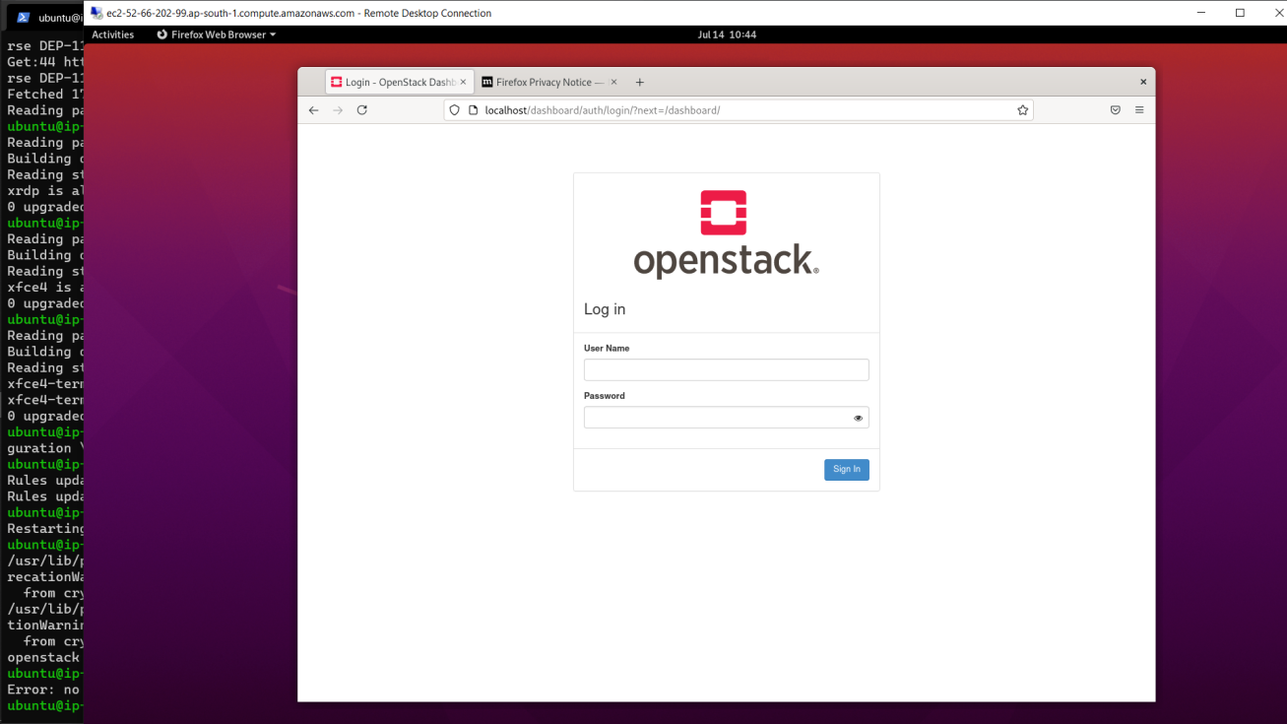
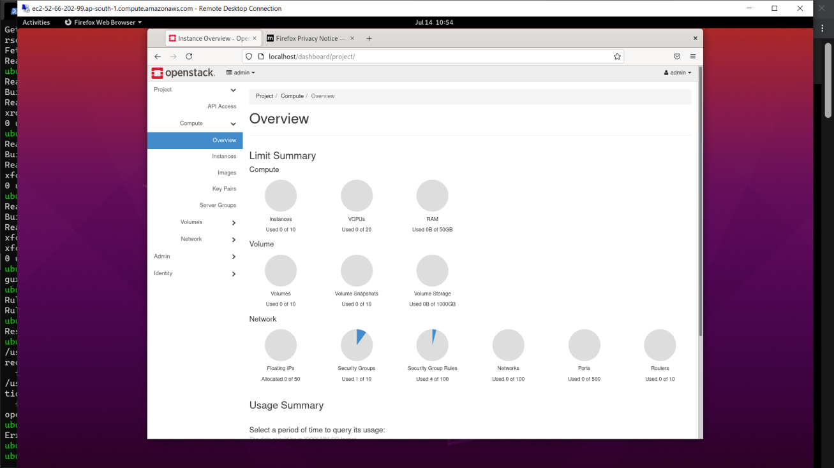
Our OpenStack Dashboard

Slide 21

Conclusion
We have completed all the assigned task
It was a great learning opportunity in this training
We’ve learnt many great technologies which are used in today’s world.

Slide 22
References
https://docs.openstack.org/devstack/latest/
https://mindmajix.com/openstack-tutorial#aws
https://linuxhint.com/install_apache_web_server_ubuntu/
https://www.w3schools.com/

Slide 23
Thank You

